Slide 1
Digital Portfolio
STUDENT NAME: NAVANITHINI R
REGISTER NO AND NMID: 2422K0029 AND asbruap2422k0029
DEPARTMENT: COMPUTER SCIENCE
COLLEGE:PPG COLLEGE OF ARTS AND SCIENCE/BHARATHIYAR UNIVERSITY

Slide 2
PROJECT TITLE
Simple portfolio

Slide 3


AGENDA
Problem Statement
Project Overview
End Users
Tools and Technologies
Portfolio design and Layout
Features and Functionality
Results and Screenshots
Conclusion
Github Link
3/21/2024 Annual Review

Slide 4

PROBLEM STATEMENT
In today’s digital world, having an online presence is essential for students and professionals. Many students lack a central platform to showcase their skills, academic background, and projects to potential recruiters or collaborators. The goal of this project is to create a personal portfolio website for Navanithini, a Computer Science student, to present her qualifications and achievements effectively.

Slide 5

PROJECT OVERVIEW
This project involves the development of a responsive and simple portfolio website using HTML and CSS. The site allows Navanithini to introduce herself, highlight her skills and academic projects, and provide contact information for networking or job opportunities. The website is designed to be user-friendly and visually clean.

Slide 6

WHO ARE THE END USERS?
The portfolio website is aimed at the following users:
Recruiters and Employers looking for fresh talent in software development.
Academic institutions or mentors reviewing student work.
Peers and collaborators interested in teaming up on tech projects.
General visitors who want to learn more about Navanithini's skills and background.

Slide 7

TOOLS AND TECHNIQUES
HTML5 – To structure the content of the portfolio.
CSS3 – For styling the layout and responsiveness.
(Optional extensions):
JavaScript – For interactive elements (e.g., theme toggle, dynamic content).
GitHub – To host and manage version control of the project.

Slide 8
POTFOLIO DESIGN AND LAYOUT
The portfolio consists of the following sections:
Header – Includes name and short tagline.
Navigation Bar – Links to different sections (About, Projects, Contact).
About Section – Brief introduction and background.
Projects Section – List of academic or personal projects with descriptions.
Contact Section – Email, GitHub, LinkedIn.
Footer – Copyright information.
The design follows a clean, modern layout with consistent spacing, readable fonts, and a mobile-friendly structure.
8

Slide 9
FEATURES AND FUNCTIONALITY
🧑‍🎓 Personal Introduction
📁 Project Showcase – With titles and short descriptions.
📧 Contact Info – Email, GitHub, and LinkedIn links.
🌐 Responsive Design – Works on mobile and desktop.
🔗 Clickable Links – Navigation and external profiles.

Slide 10
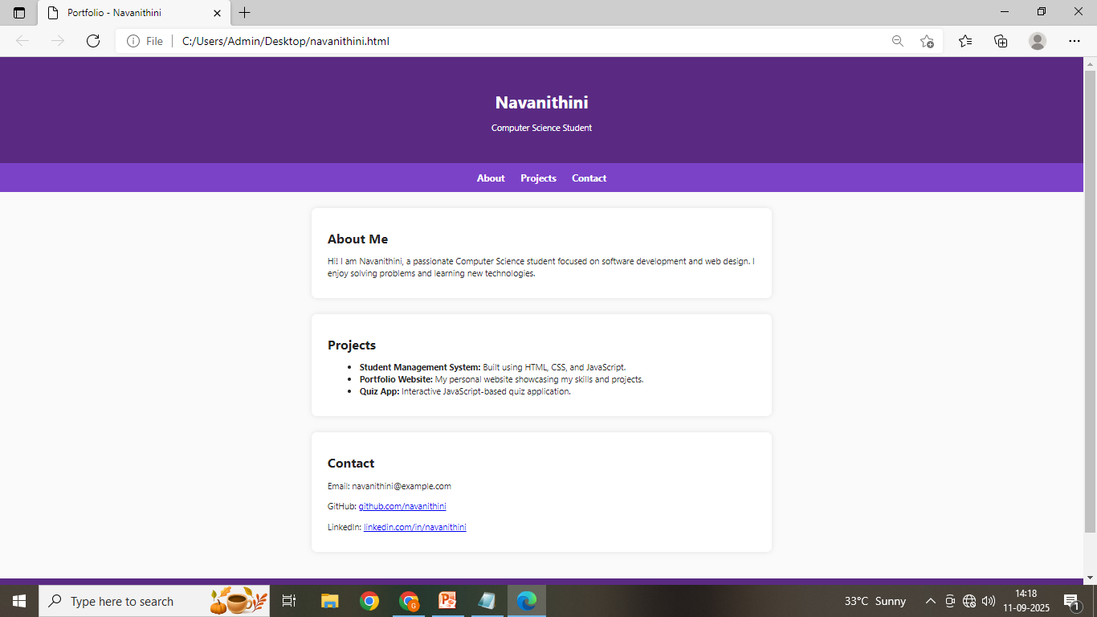

RESULTS AND SCREENSHOTS
3/21/2024 Annual Review
10

Slide 11
CONCLUSION
This project successfully demonstrates how a Computer Science student like Navanithini can build a personal portfolio using basic web technologies. The website acts as a professional online resume and helps in improving visibility and personal branding. Future improvements may include adding JavaScript functionality, a downloadable resume, or integrating a blog section.
11

